Slide 1
Lecture 2
Operating Systems (COMP1562)

Slide 2

Just talk about…
…SHELL…
Mariusz Pelc © 2012/2013
(with support from Dr Kevin McManus)

Slide 3
This will not be about…
…GUIs…
though they are higher level shells runing (usually) on top of a lower level
shell (for example
X-Window
system running
on top of
Linux shell.
GUIs
SHELL
OS
Hardware
Mariusz Pelc © 2012/2013
(with support from Dr Kevin McManus)

Slide 4
GUIs
Windows
  Windows shell
Linux
  CDE (Common Desktop Environment)
  GNOME
  KDE
  Xfce (very lightweight)
Mariusz Pelc © 2012/2013
(with support from Dr Kevin McManus)

Slide 5
Just talk about…
…Linux SHELLs…
Mariusz Pelc © 2012/2013
(with support from Dr Kevin McManus)

Slide 6
Linux shells list
Bourne shell (sh)
  Almquist shell (ash)
  Debian Almquist shell (dash)
  Bourne-Again shell (bash)
  Korn shell (ksh)
  Z shell (zsh)
C shell (csh)
  TENEX C shell (tcsh)
Mariusz Pelc © 2012/2013
(with support from Dr Kevin McManus)

Slide 7
commands…
man - help (manual) about command given
use case: man command
pwd - returns current directory location
use case: pwd
cd - change current directory
use case: cd [directory_name]
ls - list directory content
use case: ls [option] [directory_name]
selected options:
-a - list all files (including hidden ones)
-l - list full information about files
-R - list directory content recursively (including subdirectories content)
-S - sort output based on files size
-1 - display each file in new line
Mariusz Pelc © 2012/2013
(with support from Dr Kevin McManus)

Slide 8
commands…
cat - display file content
use case: cat [option] file_name
options:
-n - display additionally line numbers
mkdir - create a new directory
use case: mkdir [option] directory_name
options:
-p - create a given directory branch
(for example mkdir -p a/b/c <=> mkdir a; mkdir a/b; mkdir a/b/c)
rmdir - remove a directory (empty)
use case: rmdir [option] directory_name
options:
-p - remove a given directory branch
(for example rmdir -p a/b/c <=> rmdir a; rmdir a/b; rmdir a/b/c)
Mariusz Pelc © 2012/2013
(with support from Dr Kevin McManus)

Slide 9
commands…
cp - copy files
use case: cp [option] source destination
selected options:
-i - interactive mode (need to confirm each copying file)
-r - recursive copying (including subdirectories)
-R - recursive copying (including subdirectories and fifo files)
-u - update destination (only newer files are copied)
-f - forced copying (destination will get replaced)
rm - remove files (or directories if –r/-R option is used)
use case: rm [option] file(s)
options:
-i - interactive mode
-r, -R - remove recursively (a directory with subdirectories)
Mariusz Pelc © 2012/2013
(with support from Dr Kevin McManus)

Slide 10
commands…
mv - rename/move files
use case: mv [option] source destination
options:
-i - interactive mode
touch - create an empty file (or update date of existing one)
use case: touch file_name
alias - create a command alias
use case: alias [alias_name=„system_command"]
unalias - remove existing alias
use case: unalias alias_name
Mariusz Pelc © 2012/2013
(with support from Dr Kevin McManus)

Slide 11
commands…
find - search for files
use case: find [path] criteria
where:
path - a path (directory) to be search fora file
criteria - search criteria:
-name name - search for the file name
-perm perm - search for a file with the permissions given
-size [+/–]n - search for a file with the given size
-type c - search for a file of the type given
-user name - search for a file that is own by the user given
-group nazwa - search for a file that belongs to the group given
-a,-c,-mmin n - search for a file that was: -amin – accessed, -cmin – created,
-mmin – modified; n – minutes ago
-a,-c,-mtime n - search for a file that was: -atime – accessed, -ctime – created,
-mtime – modified; n – days ago
-nouser - with no owner
-nogroup - with no group
Mariusz Pelc © 2012/2013
(with support from Dr Kevin McManus)

Slide 12
Just talk about…
grep - search for a pattern in a file or pipe
use case: grep [option] pattern file_name
options:
-c - return a number of lines in a file that contain the searched pattern
-i - case insensitive
-n - display additionally lines numbers
-v - invert the criteria (means: not containing)
-w - display only the lines where the pattern is a separate word/token
sort - sort the file or pipe content
use sace: sort [option] file_name
options:
-d - dictionary-based order
-r - inverted dictionary-based order
-n - numerical order
-i - ignore all characters out of range 32-126
-o file - write the sorted content into the file given
Mariusz Pelc © 2012/2013
(with support from Dr Kevin McManus)

Slide 13
Pipes and streams
A command
Each command has a standard input and a standard output
For example:
ls –l
the standard input for the command is the directory given (in the example this is the current directory) and the standard output is the screen (as we can see the results on the screen)
in
command
out
Mariusz Pelc © 2012/2013
(with support from Dr Kevin McManus)

Slide 14
Pipes and streams
Pipes
What will happen if we connect one command output to another command input – pipes
For example:
ls –al | grep “jpg” | wc -l
the standard input for the command1 is the current directory, input for the command2 is the output of the command1 and the input for the command3 is the output of the command1 filtered by the command2. That’s why each command used after commadn1 is called a filter.
in1
command1
out1
in2
command2
out2
in3
command3
out3
|
|
Mariusz Pelc © 2012/2013
(with support from Dr Kevin McManus)

Slide 15
Pipes and streams
Redirecting of streams takes place when we use “>”, “<“ or “>>” at the end of the command.
There are 3 streams in Linux:
Files
Screen
Keyboard
Redirection of the standard output stream of the command ls:
ls –l > file_name
The above command redirects the standard output stream of the ls command to be not the screen, but the filename given. In the result what usually is displayed on the screen – will be put into the file.
Mariusz Pelc © 2012/2013
(with support from Dr Kevin McManus)

Slide 16
Files in Linux – hard and symbolic links
Redirection of the standard input stream of the command read:
read variable_name < file_name
The above command redirects the standard input stream of the read command to be not the keyborad, but the filename given. In the result the command will not wait for the user input to assign value of the variable but will read the file content instead
Mariusz Pelc © 2012/2013
(with support from Dr Kevin McManus)

Slide 17
Files in Linux – hard and symbolic links
Linux system is using i-node as the file allocation units / file description unit. The structure will be described in another lecture.
Each i-node can have a symbolic or hard link (users can create them).
Symbolic links | Hard links
Tied with the file name | Tied with the file location (i-node)
Automatically recovers connection to the deleted file when recreated in the same location | No automatic recovery
Can point at the directory | Can point at the files only
Mariusz Pelc © 2012/2013
(with support from Dr Kevin McManus)

Slide 18
Files in Linux – hard and symbolic links
Symbolic and hard links can be created using ln command. By default hard links are created.
ln - create hard/symbolic link to a file
use case: ln [option] file_name link_name
options:
-s - create the symbolic link
Mariusz Pelc © 2012/2013
(with support from Dr Kevin McManus)

Slide 19
Just talk about…
…Windows SHELL (cmd)…
Mariusz Pelc © 2012/2013
(with support from Dr Kevin McManus)

Slide 20
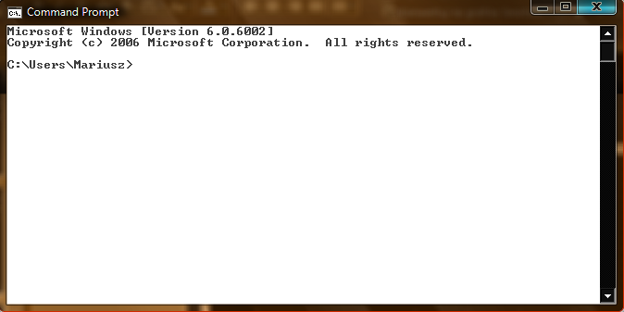
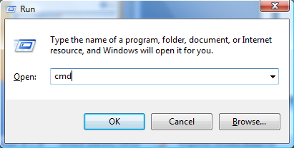
cmd…
Mariusz Pelc © 2012/2013
(with support from Dr Kevin McManus)

Slide 21
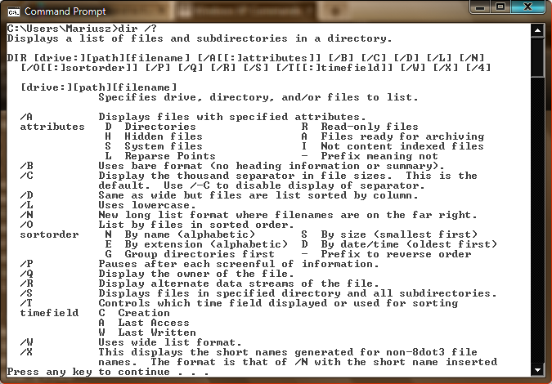
cmd…
Mariusz Pelc © 2012/2013
(with support from Dr Kevin McManus)

Slide 22
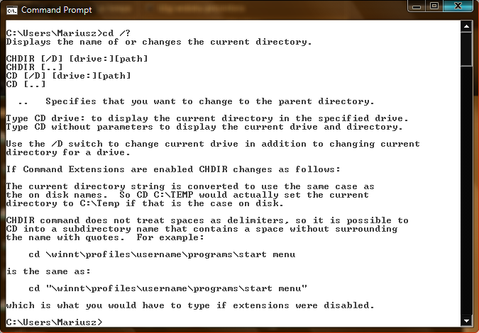
cmd…
Mariusz Pelc © 2012/2013
(with support from Dr Kevin McManus)

Slide 23
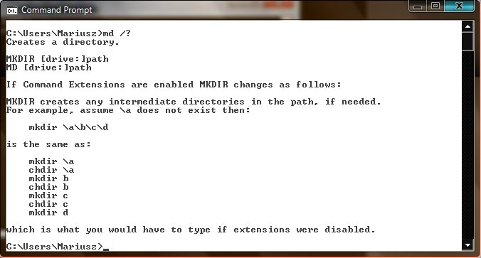
cmd…
Mariusz Pelc © 2012/2013
(with support from Dr Kevin McManus)

Slide 24
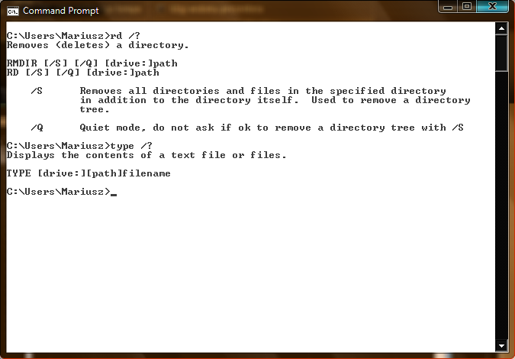
cmd…
Mariusz Pelc © 2012/2013
(with support from Dr Kevin McManus)

Slide 25
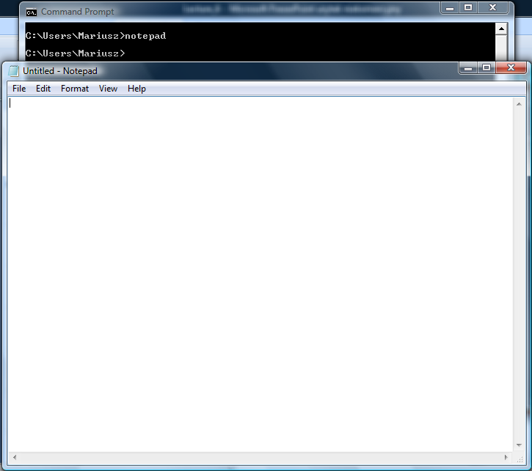
cmd…
Mariusz Pelc © 2012/2013
(with support from Dr Kevin McManus)

Slide 26
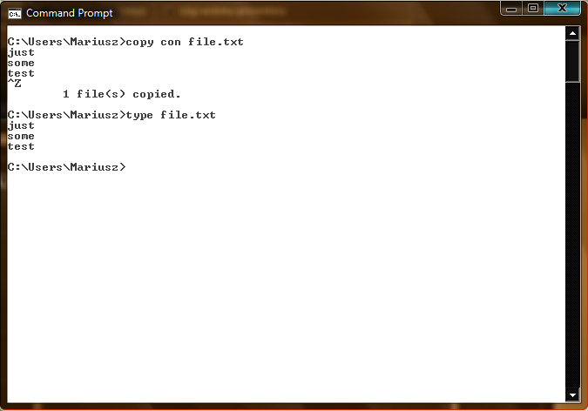
cmd…
Mariusz Pelc © 2012/2013
(with support from Dr Kevin McManus)

Slide 27
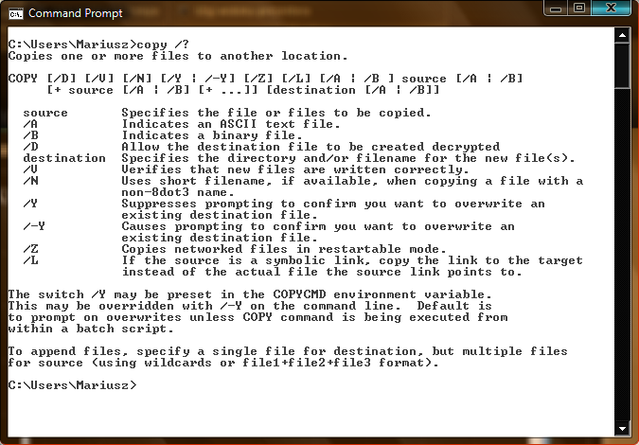
cmd…
Mariusz Pelc © 2012/2013
(with support from Dr Kevin McManus)

Slide 28
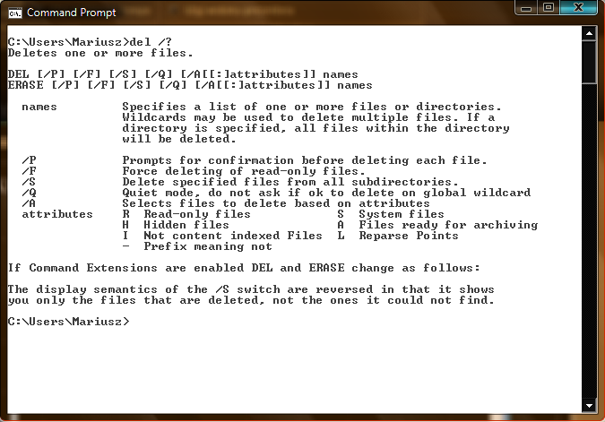
cmd…
Mariusz Pelc © 2012/2013
(with support from Dr Kevin McManus)

Slide 29
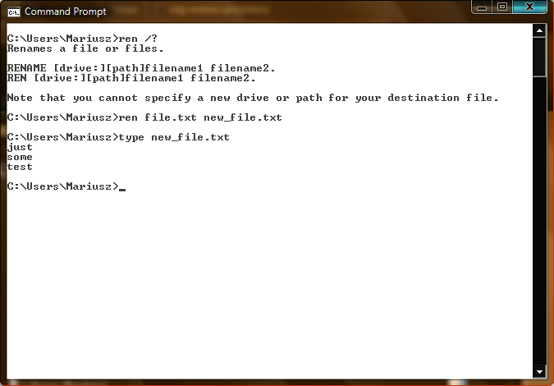
cmd…
Mariusz Pelc © 2012/2013
(with support from Dr Kevin McManus)

Slide 30
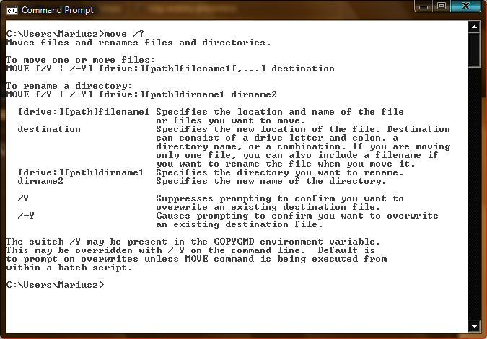
cmd…
Mariusz Pelc © 2012/2013
(with support from Dr Kevin McManus)

Slide 31
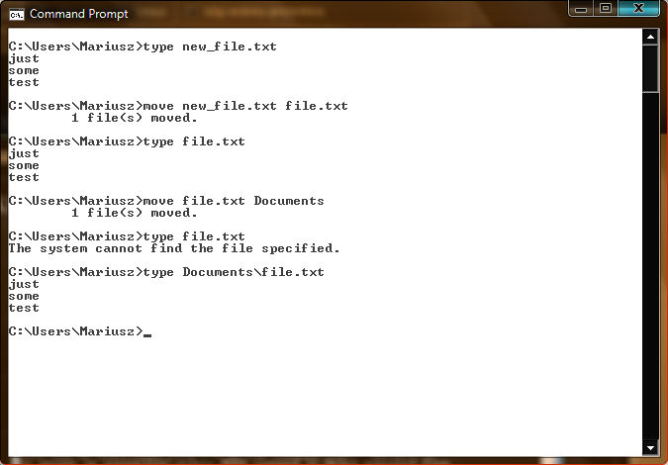
cmd…
Mariusz Pelc © 2012/2013
(with support from Dr Kevin McManus)

Slide 32
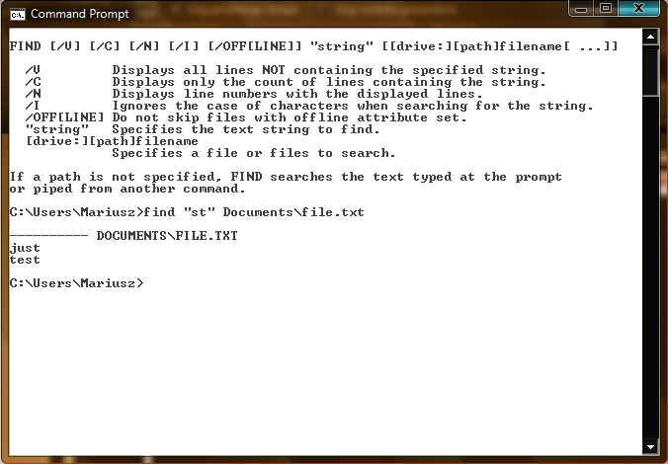
cmd…
Mariusz Pelc © 2012/2013
(with support from Dr Kevin McManus)

Slide 33
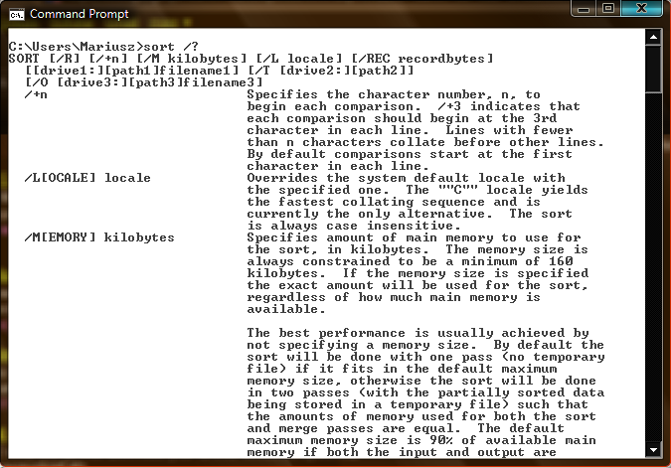
cmd…
Mariusz Pelc © 2012/2013
(with support from Dr Kevin McManus)

Slide 34
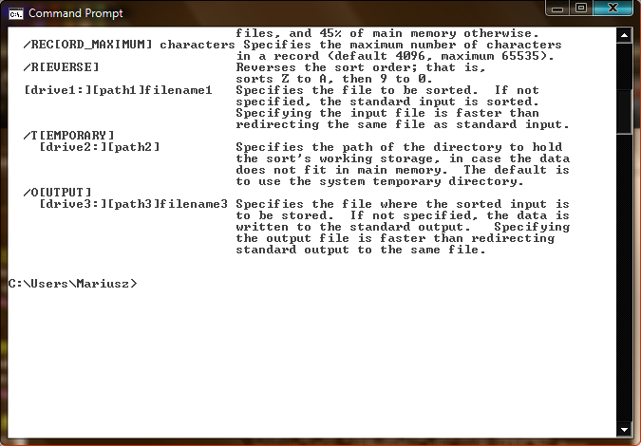
cmd…
Mariusz Pelc © 2012/2013
(with support from Dr Kevin McManus)

